Slide 1
Ant Colony Optimisation
Dr Jonathan Thompson,
School of Mathematics, Cardiff University

Slide 2
Outline
Introduction to ant algorithms
Overview of implementation for TSP (Dorigo et al.)
Application to Dynamic Vehicle Routing (Wallace and Thompson)
Application to Room Fitting (Thompson)
Application to Examination Timetabling / Graph Colouring (Dowsland and Thompson)
Conclusions

Slide 3
Classification of Meta-heuristics
Osman divided meta-heuristics into:
Local search
Population
Construction

Slide 4
Solution Space
Feasible regions

Slide 5
Local Search
Solution Space

Slide 6
Local Search
Solution Space

Slide 7
Local Search
Solution Space

Slide 8
Population Based
Solution Space

Slide 9
Population Based
Solution Space

Slide 10
Construction
Solution Space

Slide 11
Construction
Solution Space

Slide 12
Construction
Solution Space

Slide 13

Ant Algorithms

Slide 14

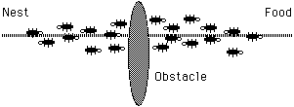
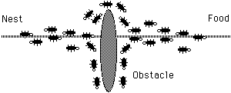
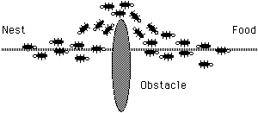
The Ant System in Nature

Slide 15
Ant Algorithms
Proposed by Dorigo et al.
Probabilistic greedy construction heuristic
Probabilities are adjusted according to information on solution quality gained from previous solutions
Initially use limited to routing problems but now being applied to a broad range of problems.

Slide 16
Ant Systems for the TSP
No. ants = No. cities
Each ant i produces a (probabilistic) solution, cost c_{i}
Trail between each pair of cities in route i = trail + Q/c_{i}
Trail is subject to evaporation i.e. trail = trail * σ, σ < 1
Each ant chooses next city with a probability proportional to the distance and the trail.

Slide 17
Ants for TSP
Probability of next city from i being k is
P(_{ik}) = [τ_{ik}]^{α} [μ_{ik}]^{β}
Σ [τ_{jk}]^{α} [μ_{jk}]^{β} where
μ_{ik} = Q / distance from i to k, τ_{ik} = trail between i and k.
Continues through generations until reaches stagnation
Has outperformed other meta-heuristics

Slide 18
The Static VRP
A set of geographically dispersed customers need to be serviced.
All routes start and end at the depot.
A cost c_{ij}, is associated with travelling from customer i to customer j.
Customer i has demand D_{i}, vehicles have capacity Q
Construct a set of routes such that cost is minimised and each customer is visited once and capacity constraints are satisfied.

Slide 19
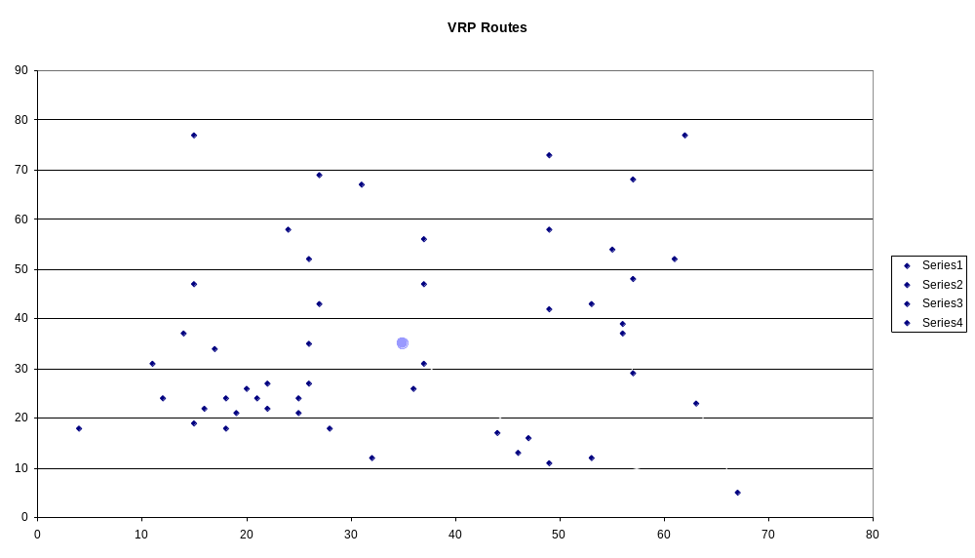
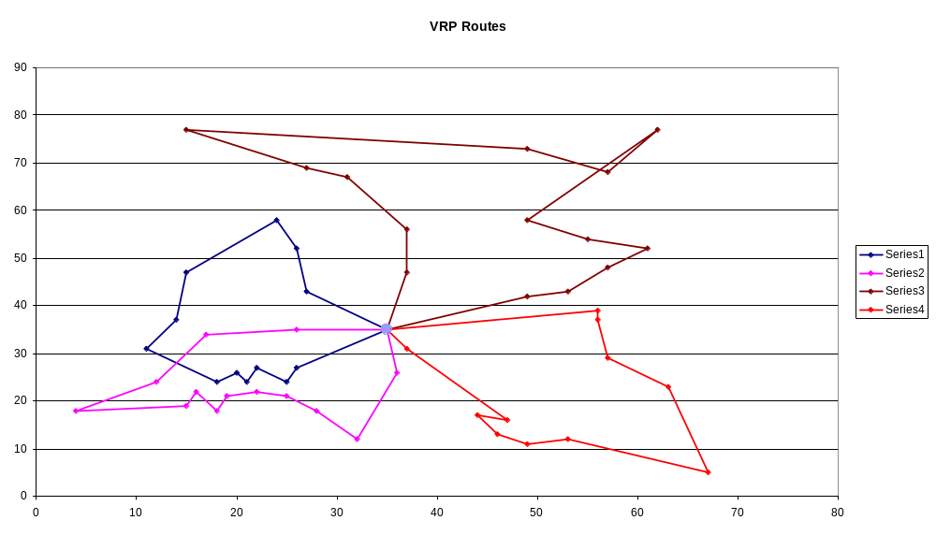
Example VRP

Slide 20
Adding Dynamism (DVRP)
Static VRP
  Customers are known a priori and do not change after the routes have been constructed.
Dynamic VRP
  Customers can change after the initial routes have been constructed.

Slide 21
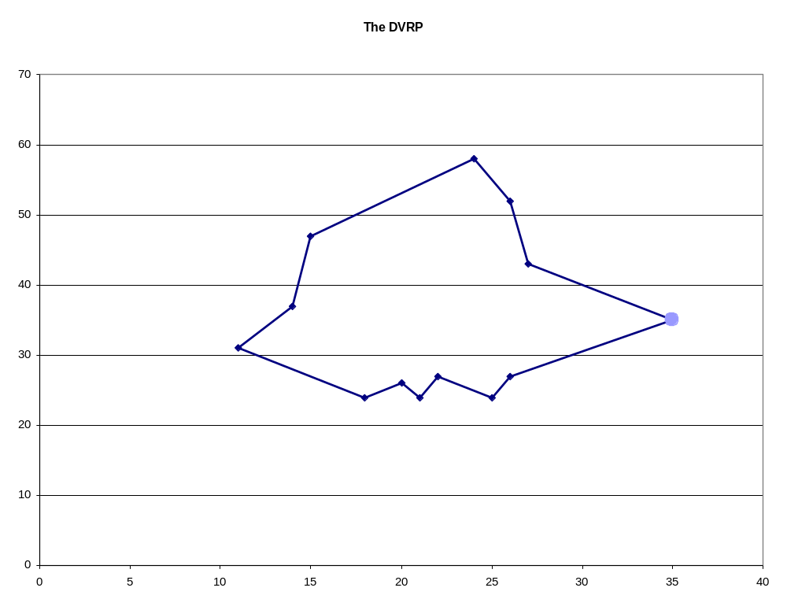
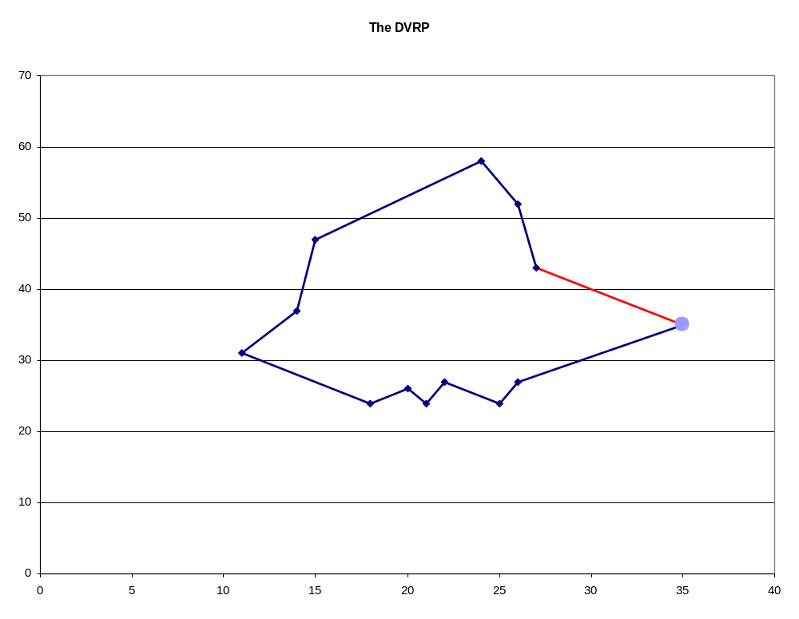
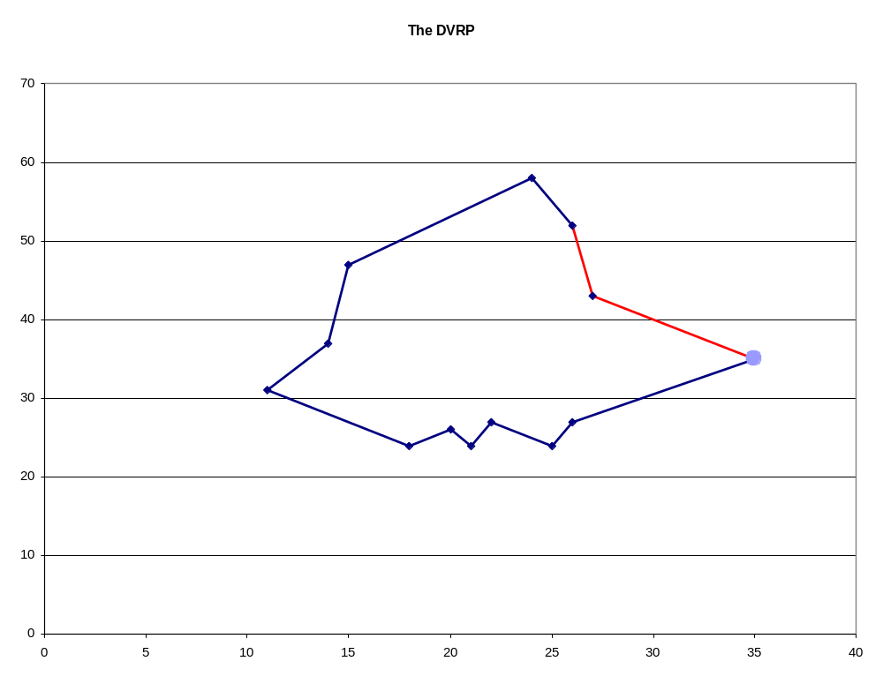
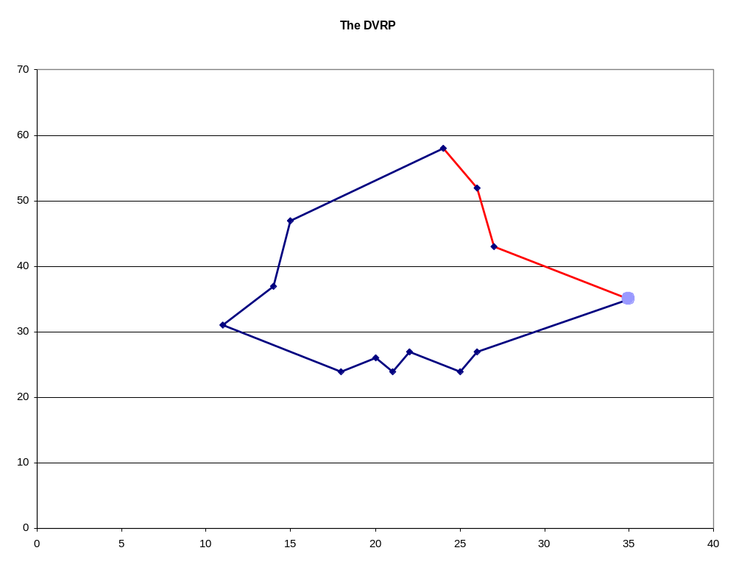

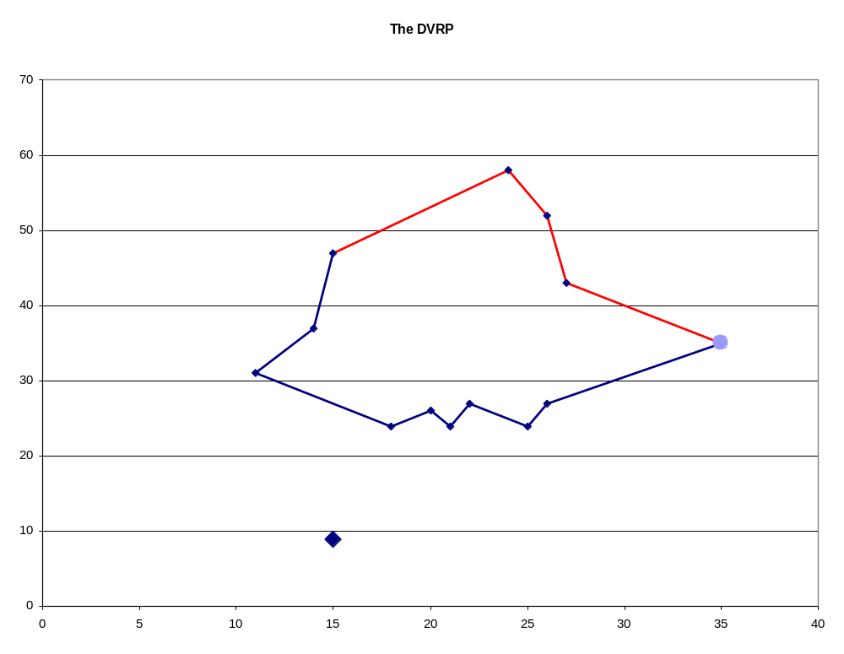
Graphically Explained
New Customer Arrives
What happens now ?

Slide 22
Two Solution Approaches
Insertion Heuristics
  Insert the new customers in the current routes.
  Improvement heuristics when system is idle.
Re-Optimization i.e. solve static VRPs
  Re-planning from scratch when new information is received / after each time period.

Slide 23
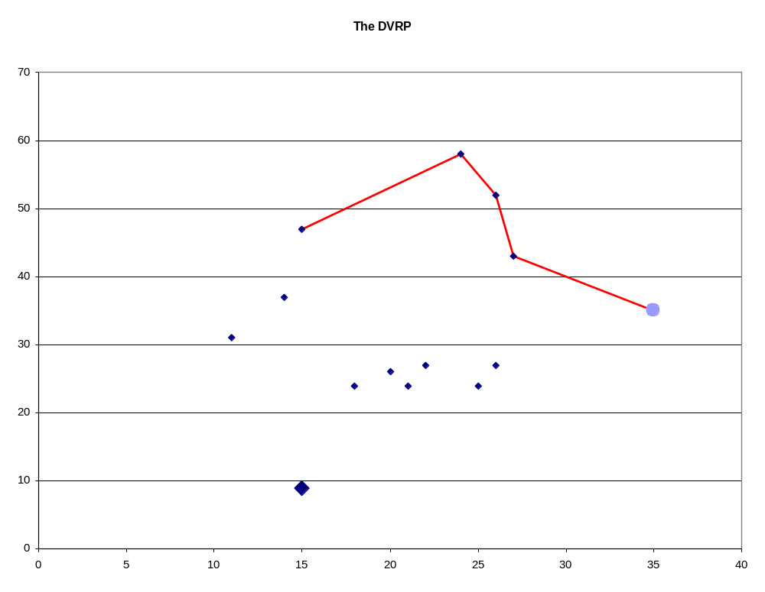
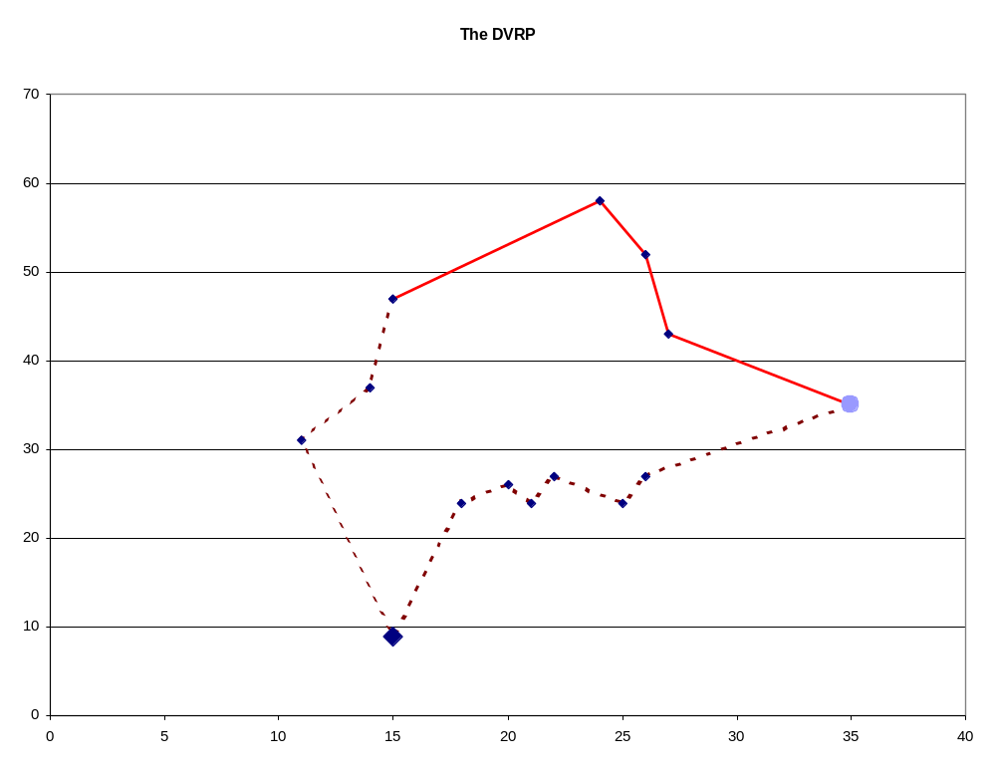
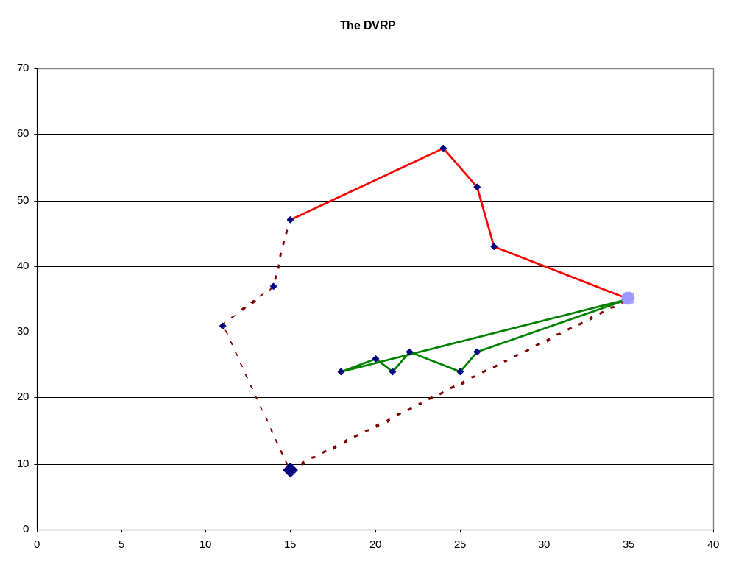
Graphically Explained – Re-Opt
New Customer Arrives
Current route is discarded.
If capacity is not exceeded then a new route is created.
If exceeded then new routes are constructed

Slide 24
ACS-DVRP Pseudo-code
Overnight, an initial solution is created and commit drivers to customers for first time period + small commitment time.
Each time period is then considered in turn.
Customers = existing customers who have not been committed to + new customers who arrived during the previous time slot.
Solve problem during current time period and commit drivers to customers if start time is within the subsequent time period
Continue until all customers are committed to.

Slide 25
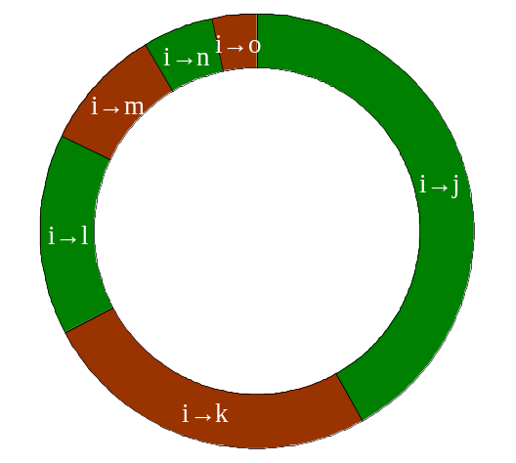
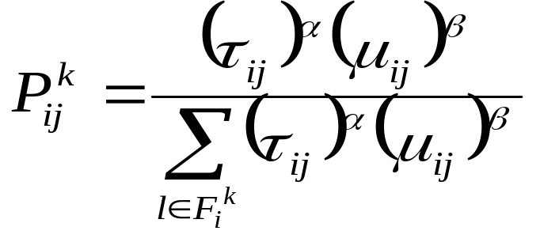
Roulette Wheel Choice
A schedule is being created, truck is at customer i.
A roulette wheel type selection is made to decide where to go next.
Size of the slot depends on attractiveness of the move.

Slide 26
Ants for the DVRP (ACS-DVRP)
Better solutions obtained by:
Diversification: local trail update τ_{ij} = (1 – ρ) τ_{ij} + ρ τ₀
Select best choice with probability q, probabilistically with probability (1 – q).
Elitism – only use best ant solution to update trail globally
Maintain trails from one problem to another τ_{ij} = (1 – γ) τ_{ij} + γ τ₀
Apply descent to each ant solution
Full parameter optimisation

Slide 27
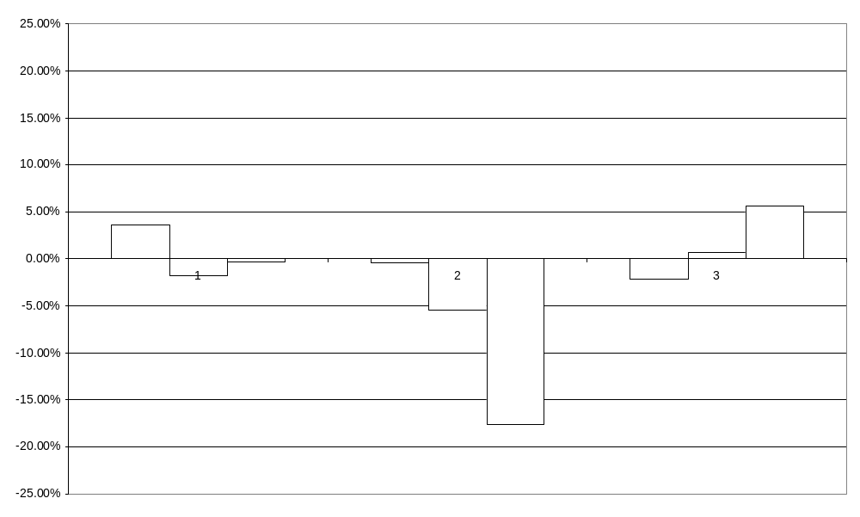
Preliminary Results
3 Data Sets
Min, Ave, Max

Slide 28
Problems with the ACS-DVRP
Sequential route construction:
  Each route is completed before the next is created.
  Customers may be scheduled in an early truck, though may have been better placed in a later one.
High variance within results:
  Difficult to interpret results.
  Minimized through use of trials.

Slide 29
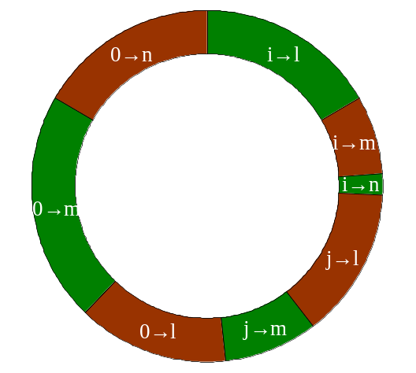
Extended Roulette Wheel
Consider more than 1 truck at a time.
Consider 3 trucks, 1 at customer i, 1 at customer j and 1 at the depot
Arcs that would have been ignored previously are now considered.

Slide 30
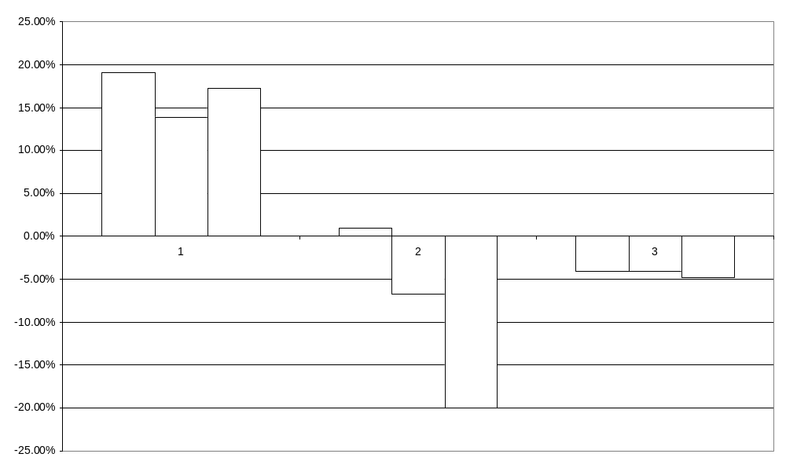
Extended Roulette Wheel Results
Why ?
An increase in the number of trucks used.

Slide 31
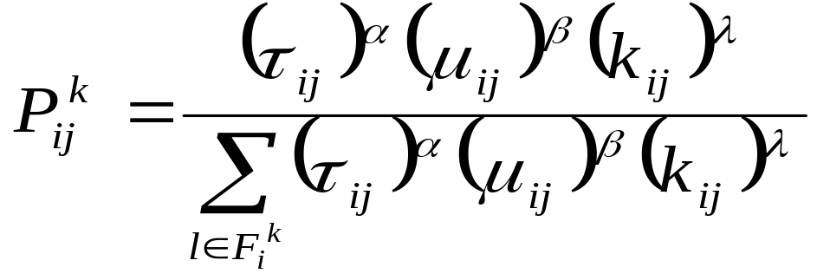
Truck Reduction Techniques
Capacity Utilization.
  Encourages the use of existing trucks over the selection of a new truck.
  Let k_{ij}=(Q_{i}+q_{j})/Q
Advanced construction formula

Slide 32
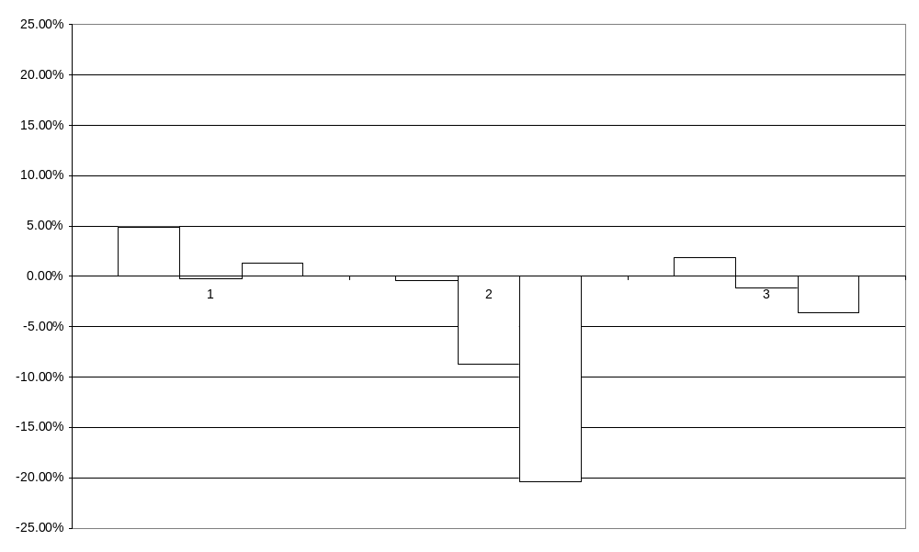
Truck Reduction Results
Reduction in average cost for each data set.

Slide 33
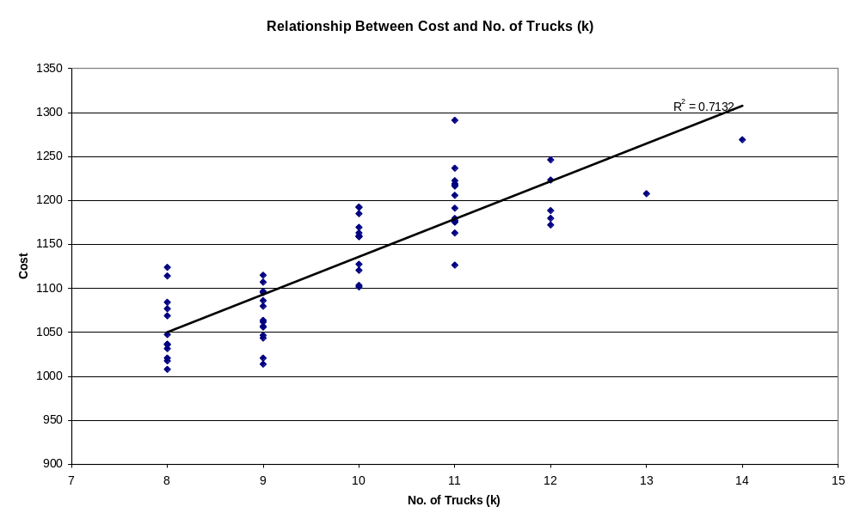
Truck Reduction Graphic

Slide 34
The Room Fitting Problem
Allocate examinations to rooms such that :-
no rooms are overfull
exams of different length are allocated to different rooms
Additional objectives:-
Minimise the number of split exams
Allocate exams to adjacent rooms

Slide 35
Simple Solutions
Randomly allocate exams to rooms
Evaluate cost function = overflow + number of pairs of exams of different duration in the same room
Randomly move a single exam to a new room or swap two exams
Apply local search - SA / TS etc.

Slide 36
Ants for Room Fitting
Number of ants = number of exams
Exams ordered according to size / duration
Initially, each ant i produces a solution, with cost c_{i}.
Possible trail: Between pairs of exams? (τ₁)
Or Between exams and rooms (τ₂)
τ₁(j,k)= τ₁ (j,k) + 100/c_{i} if ant i places exams j and k in the same room
τ₂ (j,l) = τ₂ (j,l) + 100/c_{i} if ant i places exam j in room l
All trails are reduced by an evaporation rate

Slide 37
Ants for Room Fitting
Each ant now produces another solution, by considering each exam in turn and choosing which room to place it in according to the two trails and the immediate cost.
The trails are combined so that the trail associated with allocating exam j to room k is combined with the trails between exam j and any other exams already allocated to room k.

Slide 38
The Trails
How should we combine the trails?
Average of all trails.
Average of the two trails.
Alter the factor applied to each trail according to the cost function.
When producing trails, just use part of cost function concerning each trail.

Slide 39
Experiments
Data Set One - Artificial, Optimal cost = 0, one optimal solution only. Size varies from 5 rooms, 13 exams to 20 rooms, 70 exams
Data Set Two - Real, Optimal cost is unknown. Size varies from 12 exams to 90 exams.
Five random runs
Best parameters found by experimentation with artificial data, then used on real data set.

Slide 40
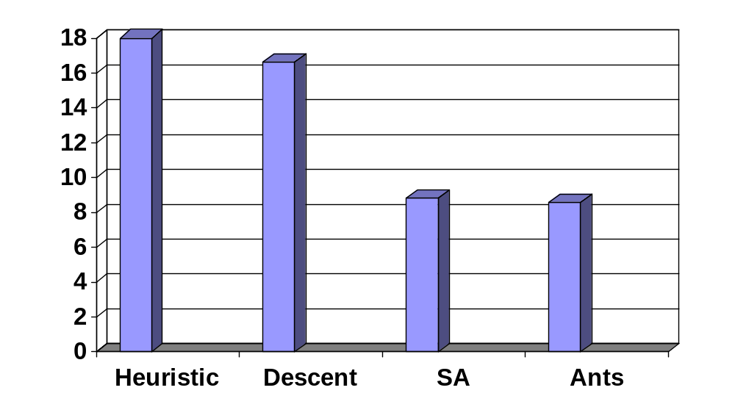
Results from Artificial Data

Slide 41
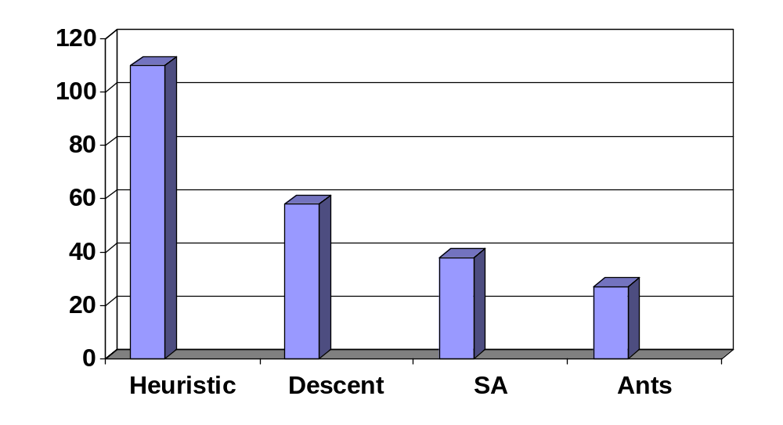
Results from Real Data

Slide 42
Graph Colouring
Given a Graph with a set of vertices and a set of edges, assign to each vertex a colour so that no adjacent vertices have the same colour.
NP-Complete
Applications include timetabling, frequency assignment and register allocation.

Slide 43
Ants for Graph Colouring
Costa and Hertz, Ants Can Colour Graphs (1997)
Each ant produces a solution by choosing vertices randomly in proportion to some definition of cost. Allocate to some colour.
A trail records the quality of solution when pairs of vertices are in the same colour class.
Subsequent ants construct solutions, considering cost (visibility) and trail.
Trails are subject to evaporation.

Slide 44
Ants for Graph Colouring
Normal Probabilistic selection:
Trail update:
  t_{ij} = ρt_{ij} + Σ 1/q(s) for each solution s in which vertices i and j are in the same colour class
Trail calculation:
  τ_{jk} = Σt_{ij} / |Vk| where Vk = no. vertices already coloured k.

Slide 45
Ants for Graph Colouring
Eight variants based on RLF and DSatur:
W = uncoloured vertices than can be included in current colour class
B = uncoloured vertices that cannot be included in current colour class
degX(i) = degree of vertex i in subgraph of vertices X
RLF(i,j), i = visibility, j = choice of first vertex
i = 1 degB(i) j = 1 max degW(i)
i = 2 |W| - degW(i) j = 2 randomly
i = 3 degBUW(i)

Slide 46
Ants for Graph Colouring
DSatur(i). Visibility = saturation degree
i = 1. First available colour.
i = 2. Vertex chosen wrt visibility. Colour chosen probabilistically wrt trail.
Results are encouraging.
However Vesel and Zerovnik (2000) question quality of results.

Slide 47
Improvements - Reward Function
40 colour graph
No. Colours Trail Ratio
41 1
42 0.976
43 0.953
44 0.932
10 colour graph
No. Colours Trail Ratio
11 1
12 0.917
13 0.846
14 0.785

Slide 48
Improved Reward Function
Instead reward function
= 1
q(s) - r
where r = best solution so far
N colour graph
No. Extra Trail Ratio
Colours
1 1
2 0.5
3 0.33
4 0.25

Slide 49
Further Improvements
Solution 1
r colours
r^{th} colour class contains several vertices
Solution 2
r colours
r^{th} colour class contains one vertex
Instead limit number of colours to target value and use number of uncoloured vertices u(s) as the reward function.

Slide 50
Potential Problems
No trail from uncoloured vertices
Instead trail between uncoloured vertices and all other vertices is increased by 1/u(s)
This is a diversification function.

Slide 51
Experiments
Initially used examination scheduling data
Known number of colours (number of timeslots)
Some structure to graphs
Larger number of large cliques than random graphs

Slide 52
Examination Scheduling Data
7 datasets from Carter
Problem sizes vary between 80 and 487 vertices
Density varies between 6% and 29%
Maximum clique between 10 and 21
Clique vertices have high degree
Optimal colouring between 10 and 21

Slide 53
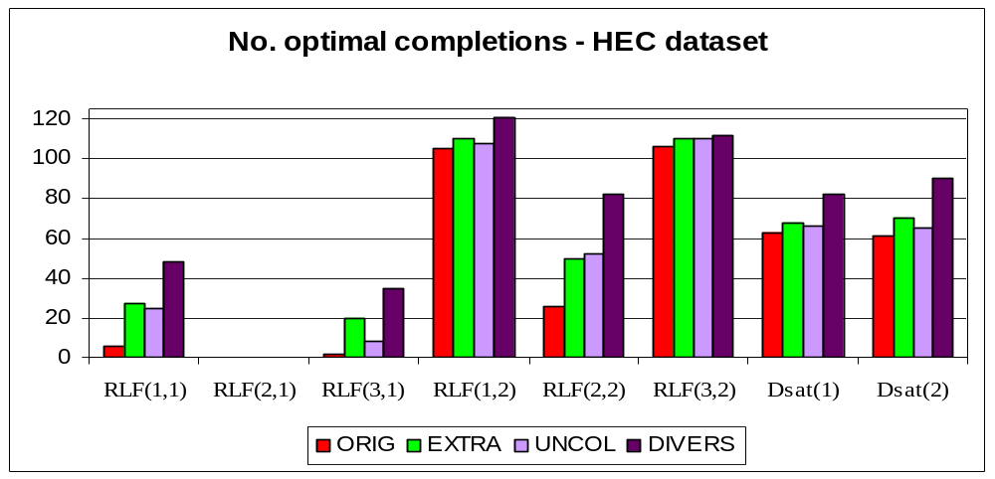
Results for Sample Dataset

Slide 54
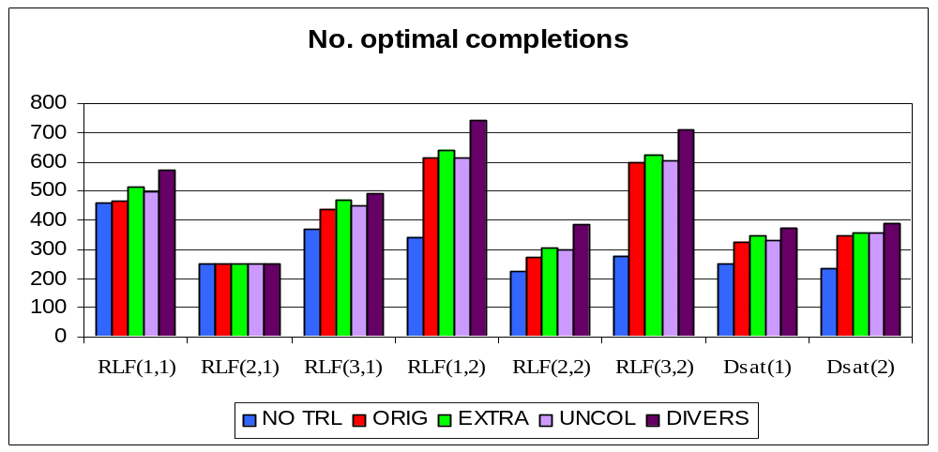
Results for all Datasets

Slide 55
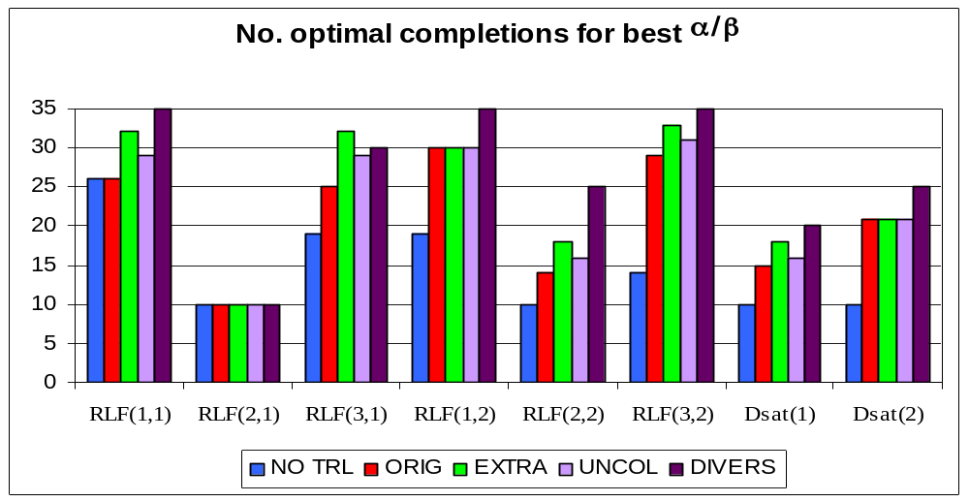
Results for Best Parameters

Slide 56
Best Ant Implementation
RLF(1,2)
Reward function of 1/u(s)
Diversification included
Alpha = 2, higher beta values (4 or 5)
Evaporation rate = 0.5
Results confirmed on larger datasets
Results comparable to those of other researchers

Slide 57
Random Graphs
Graphs used by Costa and Hertz (from Ferland and Fleurent)
20 G(100,0.5), 10 G(300,0.5), 5 G(500,0.5) and 2 G(1000,0.5)
Size C & H D & T
100 15.2 15.15
300 35.7 34.5
500 55.6 53.0
1000 111.0 100.5

Slide 58
Random Graphs
Graphs used by Costa and Hertz (from Ferland and Fleurent)
20 G(100,0.5), 10 G(300,0.5), 5 G(500,0.5) and 2 G(1000,0.5)
Size C & H D & T C et al.
100 15.2 15.15 14.95
300 35.7 34.5 33.3
500 55.6 53.0 49.5
1000 111.0 100.5 85.0

Slide 59
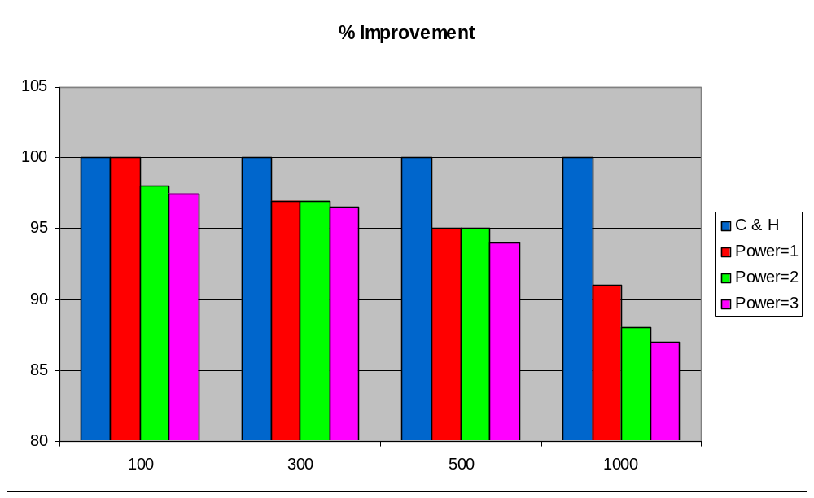
Random Graphs
Emphasise diversity function by raising to power

Slide 60
Improvements
Improve Construction – make several attempts at each colour class and select the one that minimises the no. edges in remaining graph
Change evaluation function to no. clashing edges if vertex inserted into best colour class
Add local search

Slide 61
Local Search
Shuffle – Reorder colours and move vertices into earlier colours if possible. Focus on likely colour classes i.e. consider them last.
Tree. Depth first search where uncoloured vertices are coloured into colours with least clashes, and clashing vertices are moved out, and we try to colour them elsewhere.
Tabu Search, considering clashing vertices. Tabu list contains vertex colour pairs

Slide 62
Best Results
Graph | G & H | Ants | Time (secs)
Le450_15 | 15.4 | 15.0 | 43.0
Le450_25 | 26.0 | 25.8 | 365.0
Flat300 | 31.4 | 31.0 | 361.4
DSJC500 | 48.5 | 49.0 | 2007.6
DSJC250 | 28.1 | 28.0 | 440.2
G500 | 49.0* | 49.0 | 1811.1
* = Costa et al.

Slide 63
Conclusions
Ant colony optimisation is a competitive meta-heuristic for a wide variety of problems
Often needs extra assistance e.g. local search
Need the correct balance between intensification and diversification (exploitation and exploration)
Randomness is important
Parameter heavy
Future – consider more ill-structured / dynamic / stochastic problems

